Slide 1
Filtering in Frequency Domain

Slide 2


Sampling
Why does a lower resolution image still make sense to us? What do we lose?
Image: http://www.flickr.com/photos/igorms/136916757/

Slide 3
Sampling
Upsampling
Downsampling

Slide 4
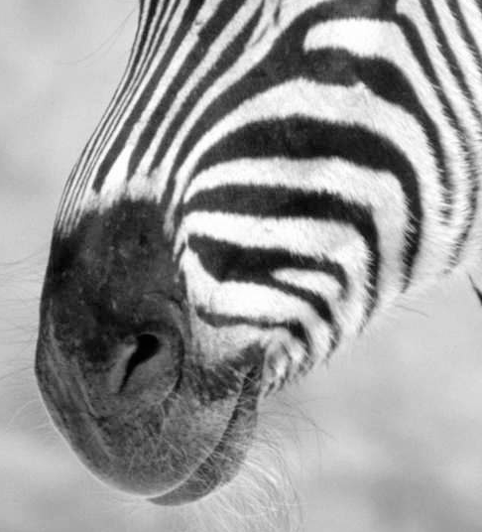
Subsampling by a factor of 2
Throw away every other row and column to create a 1/2 size image

Slide 5
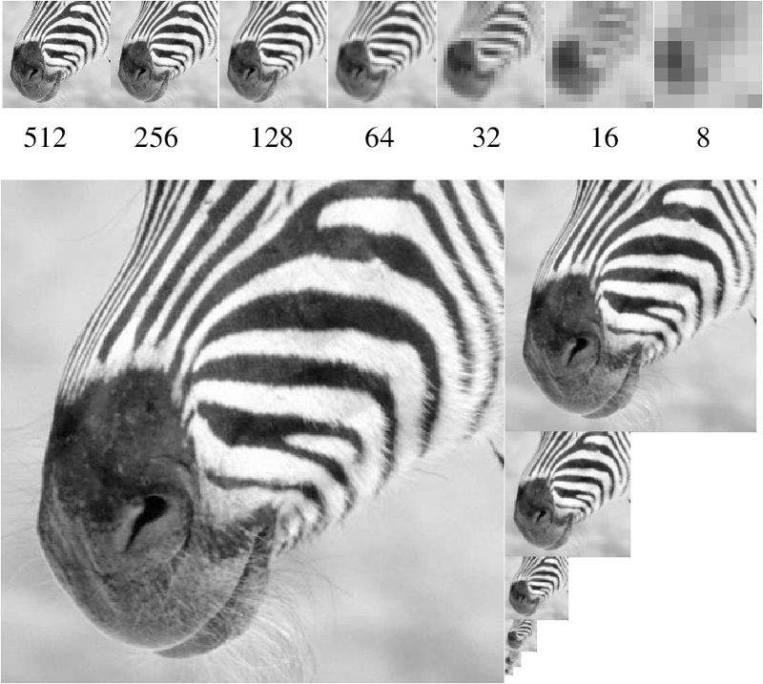
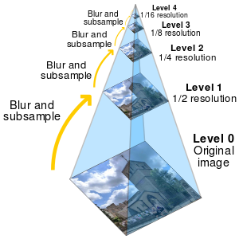
Figure from David Forsyth
A ‘bar’ in the big images is a hair on the zebra’s nose; in smaller images, a stripe; in the smallest, the animal’s nose
Image pyramid

Slide 6
Algorithm for downsampling by factor of 2
Start with image of w x h
Sample every other pixel
im_small = image[ ::2:, ::2 ]
Repeat until im_small is 1 pixel large.
Hays

Slide 7
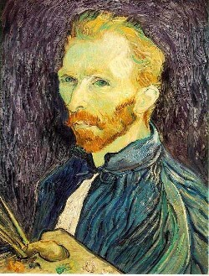
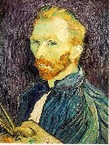

Image sub-sampling
1/8
1/4
Throw away every other row and column to create a 1/2 size image.
Steve Seitz

Slide 8

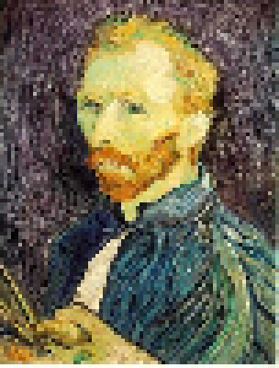
Subsampling without filtering
1/2
1/4 (2x subsample)
1/8 (4x subsample)
Steve Seitz

Slide 9
Sampling and aliasing

Slide 10
Aliasing problem
Aliasing is a signal processing term.
Aliasing occurs when you sample a signal too slowly (at a frequency comparable to or smaller than the signal being measured).
As a result, an incorrect frequency and/or amplitude is obtained.

Slide 11
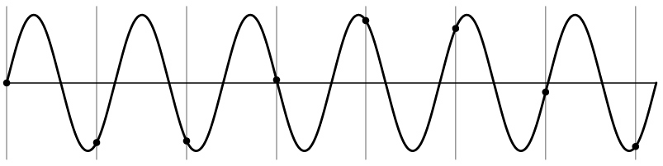
Aliasing problem
1D example (sinewave):
Source: S. Marschner

Slide 12
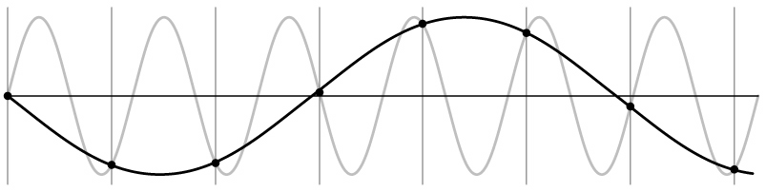
Aliasing problem
1D example (sinewave):
Source: S. Marschner

Slide 13
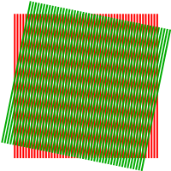
Aliasing problem
Sub-sampling may be dangerous….
Characteristic errors may appear:
“car wheels rolling the wrong way in movies”
“checkerboards disintegrate in graphics”
“striped shirts look funny on color television”
Moiré patterns
Source: D. Forsyth; Wikipedia

Slide 14
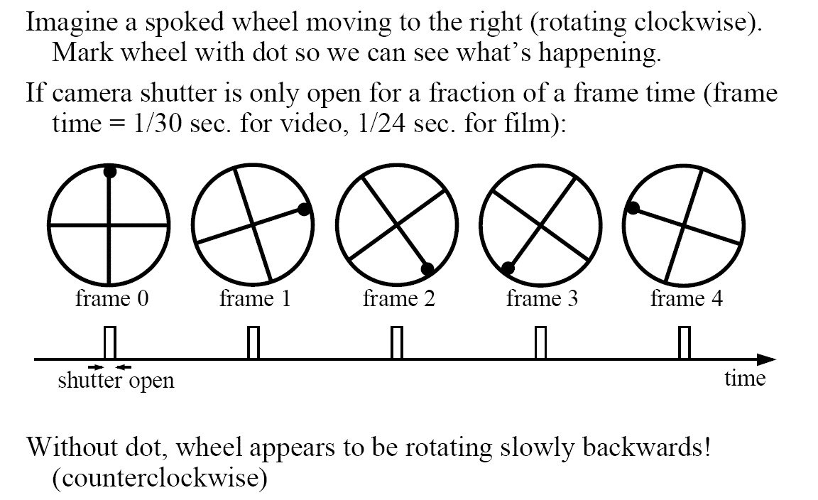
Aliasing in video
Slide by Steve Seitz

Slide 15
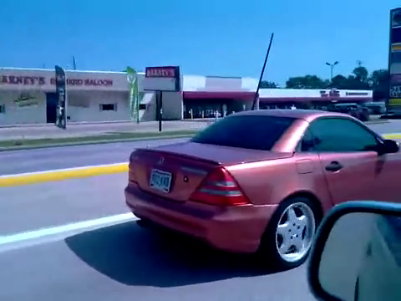

Videos
[YouTube; JoinBuzzirk; phrancque]
Notes:
https://www.youtube.com/watch?v=Y1yHMy0-4TM
https://www.youtube.com/watch?v=jQDjJRYmeWg

Slide 16
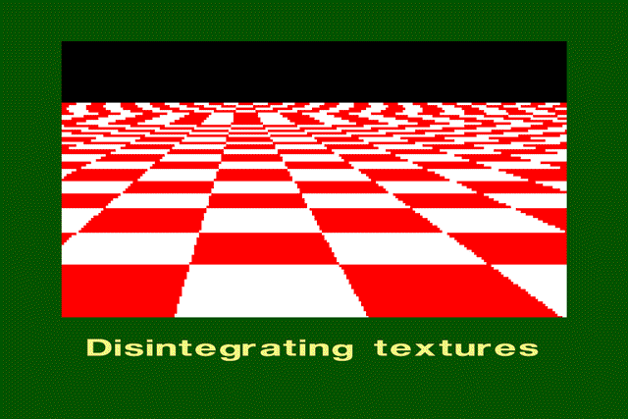
Aliasing in graphics
Source: A. Efros

Slide 17
Nyquist-Shannon Sampling Theorem
When sampling a signal at discrete intervals, the sampling frequency must be ≥ 2 × f_{max}
f_{max} = max frequency of the input signal
This allows us to reconstruct the original perfectly from the sampled version
v
v
v
good
bad

Slide 18
How to fix aliasing?
Solutions?

Slide 19
Better sensors
Solutions:
Sample more often

Slide 20
Anti-aliasing
Solutions:
Sample more often
Get rid of all frequencies that are greater than half the new sampling frequency
Will lose information
But it’s better than aliasing
Apply a smoothing (low pass) filter
Hays

Slide 21
Anti-aliasing
Forsyth and Ponce 2002

Slide 22
Algorithm for downsampling by factor of 2
Start with image(h, w)
Apply low-pass filter
im_blur = imfilter( image, fspecial(‘gaussian’, 7, 1) )
Sample every other pixel
im_small = im_blur( 1:2:end, 1:2:end );
Hays

Slide 23
Subsampling without filtering
1/2
1/4 (2x subsample)
1/8 (4x subsample)
Steve Seitz

Slide 24



Subsampling with Gaussian pre-filtering
Gaussian 1/2
G 1/4
G 1/8
Gaussian Pyramid [Burt and Adelson, 1983]
Steve Seitz

